Slide 1
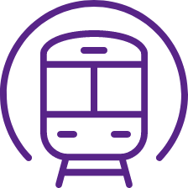
Electoral Priority 1: Investments in green and resilient infrastructure
FEDERAL
Summary and Vision
Considerably increased investments in railway infrastructure give more freedom to citizens to travel across Belgium as fewer people are disconnected from public transport, and it will also boost a modal shift towards less car transport, improving air quality, health, and liveability of cities and suburban areas. This will also benefit automobilists as traffic jams will be largely solved.
Improved telecommunications services and rollout of super-fast internet increase comfort for people and efficiency for businesses, e.g., healthcare sector would benefit a lot from it.
Main proposal 1: Solve the Rail Bottleneck in Brussels
Main Proposal 2: Upgrade Rail Infrastructure
Main Proposal 3: Access to Superfast Internet Everywhere
Delays on the entire Belgian rail network often stem from capacity saturation at Brussels Central Station (6 tracks only).
Resolving this bottleneck through infrastructure expansion ensures a resilient future for railways, benefiting present and future generations.
Volt advocates a structural solution prioritizing robustness, performance, passenger comfort, and modal shift generation (e.g., new Bxl-Midi-Bxl-Schuman tunnel, flyover viaduct, etc.).
adding tracks where technically feasible, such as 1->2, 2->3 or 2->4 tracks, to allow fast intercity-trains, slower stop-trains and trains for goods to peacefully coexist while increasing the frequency of all these trains. Upgrade some existing tracks to increase the operational speed (e.g., 120->180km/h), cutting travel times and making rail more competitive.
Reopen old railway connections to reconnect more rural areas to the railway network.
We provide incentives to accelerate 5G rollout and make sure it is unlimited and available everywhere, from cities to the most remote rural areas.
Train delays are history. Punctuality breaks records every year.
You don’t have to watch the time to board a train as the frequency of trains has increased considerably, and run later into the night.
more Belgians than ever before having easy access to a network that connects them to their desired destinations.
Wherever you are in Belgium, you have unlimited access to superfast 5G.
How Our 2040 World Looks Like + Benefits
France and Austria invest 0.46% and 0.53% of their GDP into rail infrastructure, much more than Belgium with 0.18% of GDP.
France: Planned reopening of 900 km of smaller railway lines.
France: plans to develop a RER-network in 10 urban & suburban areas other than Paris.
Inspiring European Best Practices
1. Smart State
2. Economic Renaissance
3. Social Equality
4. Global Balance

Slide 2
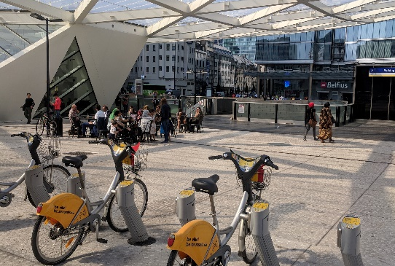
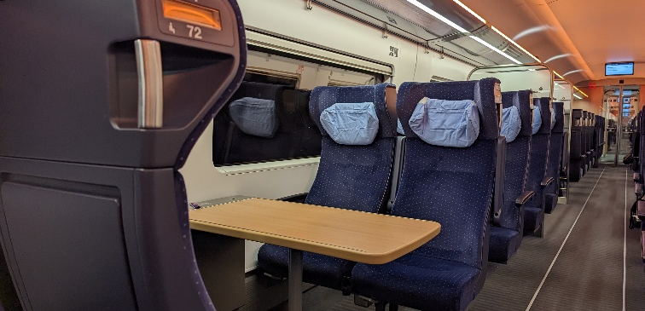
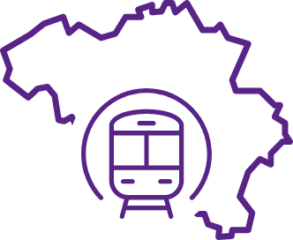
Electoral Priority 2: Mobility and Public Transport
FEDERAL
Summary and Vision
Improved operational management of public transport and more affordable tickets will provide more transportation freedom to citizens. In addition, this will decrease car use, reduce carbon emissions, improve air quality, reduce traffic jams, and improve our health
Main Proposal 1:
Night Trains within Belgium
Main Proposal 2:
Night Trains in Europe
Main Proposal 3: Simplified Ticketing System
The latest trains between each city and suburban station (e.g., Leuven and Haacht, Oud-Heverlee; Mechelen and Muizen, Willebroek) operate after midnight.
The latest trains between cities with more than 50K inhabitants, and less than 1h30 apart by train, are departing after midnight.
Between larger cities with more than 100K inhabitants, trains operate 24/7.
The ÖBB in Austria operates more than 25 daily night trains to more than 50 destinations.
Belgium should more proactively invest in the establishment of night train connections between Belgium and other European cities. By 2025, we want at least 10 daily night trains from Belgium to over 25 important European cities.
We want to introduce train passes of €5/day, €25/month and €250/year. Experiments in Germany (€9 ticket) and Spain (cheaper trains) demonstrated this is very effective in increasing the use of trains and decreasing car use to a significant extent.
Increase the pass fee by 40%, and you will also have access to the MIVB, De Lijn, and TEC networks.
If 3 million passes are sold, the current revenue from ticket sales is equalled.
Partying at PLUX, de Overpoort, or the Leuven Old Market? Going to a late university lecture? Visiting friends in another city? No reason to worry about getting home, as all trains will operate much later in the evening and night, between the middle-sized cities, even 24/7.
Want to travel to Ljubljana, Zagreb, Warsaw, Barcelona, Bratislava, Munich, Zurich, Florence, Copenhagen, Prague, Milan, Rome, Budapest without losing too much time? Jump into Belgium on the direct nightjet to those destinations.
Want or need to travel but have limited budget? No problem, with the €5 day ticket, €25 monthly pass and €250 yearly pass, Belgian rail is cheaper than ever. Always much lower than car fuel costs.
How Our 2040 World Looks Like + Benefits
The ÖBB in Austria operates over 25 daily night trains to many European cities.
In the Netherlands and Germany, some national train services between larger cities are also operating at night.
Germany already has a monthly pass of €49/month to use unlimited regional public transport.
Inspiring European Best Practices
1. Smart State
2. Economic Renaissance
4. Global Balance

Slide 3
Electoral Priority 3: Tax Justice
FEDERAL
Summary and Vision
We aim for a fair and just taxation system for individuals and entrepreneurs. Our taxation system is social, green, and fosters innovation. We also aim to reduce avoidable disease, hospitalisations, and deaths through tax reform.
Main Proposal 1:
Tax Shift and
Fair Taxes
Main Proposal 2:
Reduce Avoidable Deaths Through Taxation
Main Proposal 3:
The Future of Work
Reduced taxes on labour (strong increase in tax-free sum).
Fairer tax system for single people.
Reform of corporate tax (currently 20%‒25%), will be variable 15%‒35% depending on ESG criteria.
Introduce Capital Gain Tax.
Fiscal Fraud Effort.
Reduce fiscal incentives for salary cars for companies (no ban on salary cars), which will be partially used for infrastructure investments. Employees with a salary car will be compensated by a mobility budget that can be used up to 60% for car-related stuff, but 40% has to be spent on more sustainable forms of transportation.
VAT Reform
0% VAT on products that society benefits from if they are used in abundance: healthy food including fruits and vegetables, public transport, etc.
25% VAT on the products that harm (fellow citizens’) health: fast food, tobacco, strong liquids (>20% alc.), car purchase and maintenance.
Harmonisation of 6% and 12% VAT tariffs to 9% to make this technically feasible.
Introduce pilot-projects for a 4-day work week.
Investigate the effects on worker and company productivity, employee happiness and wellbeing, …
If those large-scale projects are successful, a 4-day work week can be rolled out in larger society
In general, we also put importance on flexibility and employee wellbeing.
Toxic leadership and cross-boundary behavior in a professional context should be dealt with better. Every employee should have the right to ecell and be be treated with dignity and respect.
An entrepreneur ? Pay less corporate taxes if you entrepreneur in a respectful way towards employment generation, human health and the environment.
In addition to the regular indexation, your net wage is increased by around 500 EUR/month or 6000 EUR/year, in addition to the regular wage indexation and independent of your current income, through a smart tax shift from labor to capital and pollution.
Pay no VAT when purchasing a bicycle, repairing a bicycle, purchasing public transport tickets and consuming healthy food like fruits and vegetables.
Work 4 days a week with a full-time salary. Enjoy life the other 3 days of the week. Working on Friday may be a thing of the past.
How Our 2040 World Looks Like + Benefits
Ireland and the UK conducted some large-scale trial projects, with very positive results. In Ireland, 85% of companies reported an increase (!) in productivity, health and wellbeing of employees was strongly improved, especially for women and 96% of participants did not want to return to a 5-day routine.
No other EU country subsidizes salary cars as much as the Belgian government. In that sense, the other EU countries have better practices.
Inspiring European Best Practices
2. Economic Renaissance
3. Social Equality
4. Global Balance

